Slide 1

Garage sale Router
CMPT 370 project

Slide 2
Title
Group number: 23
Name: Null pointers
Product name: Garage Sale Router
Group members:
1) Dorian Moore – drm481
2) Judge Michael – mij940
3) Parthvi Solanki – pas084
4) Abhi Tamakuwala – abt975

Slide 3
List of Presenters and Order
1) Dorian Moore – drm481
2) Judge Michael – mij940
3) Parthvi Solanki – pas084
4) Abhi Tamakuwala – abt975

Slide 4
Agenda
Product vision and description
Architecture
Personas
Epics
User stories implemented
Quality Assurance Plan
Next steps

Slide 5
Product vision and description
Garage Sale Finding and routing App
Product Description:
An app that allows you to post a garage sale, allows to view all of them and then plans a route on a map to all of the ones within a specified distance from the user.
-Need and Value (why do we need your product?) -It is a pain and time consuming to do this task manually.
-Stakeholders (who will use your product?) -Users who are looking to sell items in a garage sale from their house that they no longer need.
-Users who are looking for a good deal on some used items.
-Technology requirements - What do you plan to use?
JavaScript/HTML/CSS for application front end
Node.JS for back end/Server-side
Database / MongoDB

Slide 6
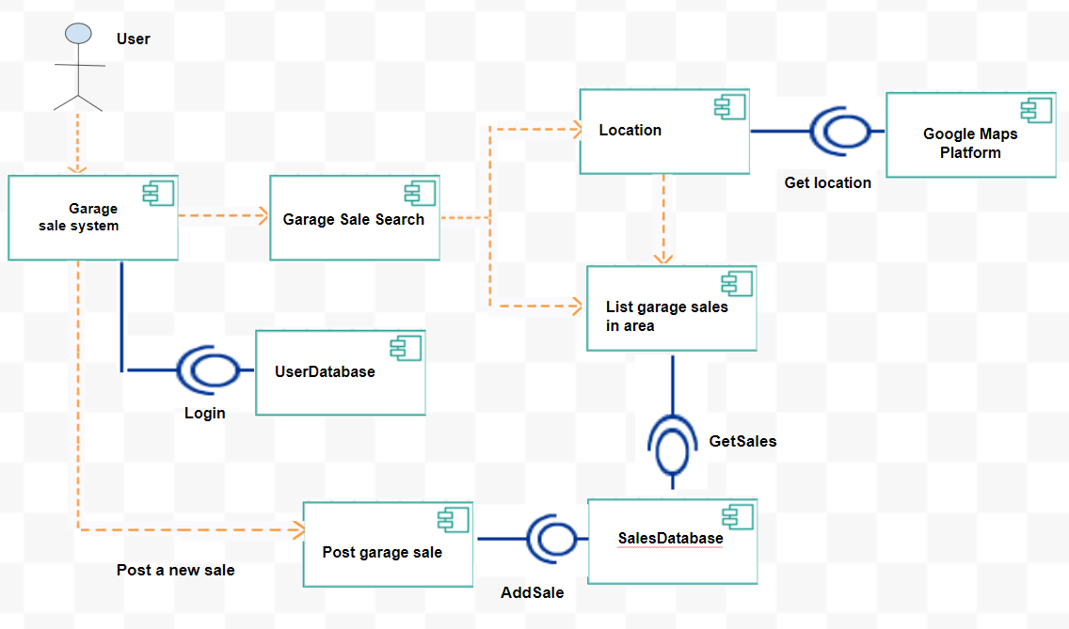
Architecture
This represents a software architecture as UML component diagram.

Slide 7
Persona 1: Retired Bob
Demographics and Experience: Bob is a married 68-year-old retired plumber. He loves watching football, drives a pickup truck with a cap on it, does woodworking in his garage as a hobby, and loves spending time with his grandkids. Bob is also an avid lover and collector of antiques. Bob does not have much experience with computers or cell phones and can become frustrated easily when presented with complex UIs.
Motivations: Bob knows that garage sales are a great place to find antiques and woodworking tools at reasonable prices. He has taken up garage sale as a hobby during his retirement because of this.
Goals/Needs: Bob is willing to drive long distances to visit garage sales that include the types of items he is interested in but doesn't mind spending time looking at random ones near him as he has lots of free time. He needs a way to find garage sales that isn't too complicated that would save himself the hassle of driving around looking for signs.

Slide 8
Epic & User stories
Epic: Bob wants to see garage sales near him quickly without much hassle.
User Story 1: A user can open the app and it immediately detects their location or asks for them to provide it.
User Story 2: A user can look at the main page once the app has their location and see a map with all the garage sales around them.

Slide 9
Persona 2: Sophia James
Demographics and Experience: Sophia is a 35-year-old married woman living at the outskirts of the city. She has 2 daughters to take care of. One is 13 years old, and the other is 6 years old. She has a Degree in Interior Designing. She also owns a very known Interior designing business. She is very passionate about learning new styles and designs. She believes that Interior designing is a field where there should be creativity, new styles, new ideas as the people in the world need change. Sophia works from morning 11 to evening 5 everyday.
Goals and needs: She visits her client's home and offices to create new designs for. She makes antique designs over there and creates them in the real world by herself at home. Sometimes, people do not tend to like her work, so she uses it to decorate her own house and replace the old items. As she mentions, she likes to change. In a span of time, she gathers a lot of items and her love for designing and antiques, she refuses to throw them away. Instead, I want to sell them to the people who are interested. She wanted some convenient way to sell her items where she does not have to send a picture of her item to an individual person or post about every single item on a site.
Motivations: She wanted to host a garage sale where she can sell her items so that her hard work and the time she invested doesn’t get wasted and some money for her passion. Frustrations: She has hosted some garage sales earlier but was not very satisfied as people were not able to find her address. She had to explain to people the way to her home due to which some didn't come at all, and some lost their way. She wants people to directly get the route to her garage sale from her address posted in her advertisement.

Slide 10
Epic & User stories
Epic: As Sophia James, I want to be able to post a garage sale for selling my used antiques and items with an option to allow me to show my exact address so that people can easily get directions for visiting and I can get the most out of it by selling my stuff.
User story 1: As Sophia James, I want to be able to post my garage sale with my address on it so that the viewers will be able to route to my sale without any problem.
User story 2: As Sophia James, I want to be able to limit the users who can view my personal information so that I can feel safe not leaking my information to everyone other than the information needed to visit my garage sale.
User story 3: As Sophia James, I want to be able to post my garage sale with filters so that my post pops up at the top for people searching for some specific items

Slide 11
Persona 3: Classical Max
Demographics and Experience: Max is 25 years old single, student of arts. He is a great lover of classical fashion and his huge collection of limited designer clothes from the 80’s and 90’s. If you go into the room, you can find all sorts of classical hats, clothes, shoes and musical equipment such as guitars, violin etc. He also admires classical music, hence the reason for him to have musical equipment.
Goals and needs: As he is a student, he can reserve limited time for his hobby. He wants to use the limited time in the best way possible so that he can look for the maximum number of items in as many number of garage sales in the specific area. He needs a system that will be easy to use and advise him of all the garage sales in the area of his interest. He would also be happy if the system allows him to display his garage sale location for other people to see.
Motivations: Max loves to collect special items related to the fashion in the 80’s and 90’s. Due to limited space in his room and the size of musical equipment, sometimes he has to trade-in or sell off some of the old stuff in exchange for new stuff. He knows that the stuff he is looking for might nowhere be in the market and he must buy them from people who have such stuff. He frequently visits garage sales which are best for personal use items and usually finds what he is looking for. In addition to that, he also sometimes hosts garage sales in order to get rid of some of his old stuff.

Slide 12
Epic & User stories
Epic: As Classical Max, I want to have a system that will show me the time required to reach a specific garage sale so I can decide whether to go or not depending on the time I have. The system should also allow me to show the location of my garage sale when I host one. The system will benefit me a lot as I am a student, it will save time and make me more productive in the limited time I spend on collecting stuff leading to less frustration.
User story 1: As Classical Max, I want to be able to search for garage sales nearest to my home that have clothing and musical items so that I can save time visiting the nearest one and find stuff that matters to me.
User story 2: As Classical Max, I want to know the route that I can follow to reach a garage sale.

Slide 13
Persona 4: Von Snipe
Demographics and Experience: Mr. Von Snipe is a 32-year-old student. He has spent a few years working in the IT industry and has returned to school to further his employment opportunities. Von drives a compact SUV, but prefers to stay home as much as possible, and only leaves the house when absolutely needed. Von is very frugal but doesn't mind spending money on things he loves. His main hobbies are fixing electronics and playing video games competitively. He likes to compete in all aspects of life, losing at anything is NEVER an option. Von Snipe is OG
Goals and needs: Von is wanting to get to the garage sale, find things he is interested in, and get back home. Von has bad eyesight so he wants to be able to customize the app to allow high contrast, and Dark Mode. Von is always up for some friendly competition in any form.
Motivations: Mr. Von wants to visit garage sales in the hope of getting good deals on electronics that he can fix or sell for a profit. He is very skilled with using computers and applications. Von gets frustrated when the application has too many steps or unwanted information to achieve his goal.

Slide 14
Epic & User stories
Epic: Von wants to be able to tailor the app to his needs for maximum efficiency. This efficiency will lead him to use the app and collect rewards faster than other users which Von wants to be able to show off.
User story 1: Ability to customize the homepage of the app to suit your needs (appearance, functions)
User Story 2: In-app rewards and achievements for bragging rights.

Slide 15
Quality Assurance Plan
The purpose of the plan is to verify the correct working ability of the project. The plan includes testing the functionality that we have written as required by the user stories and epics. This assures the quality of the software so that we limit the bugs.
Our testing strategy includes testing functionality for expected results.
Our testing starts with unit tests of individual functions where possible. Once those individual components are sufficiently tested, we move on to integration testing that ensures groups of subsystems are functioning properly together. After that is complete, we do final testing of the overall system to verify that the system meets all functional and nonfunctional requirements.

Slide 16
Quality Assurance Plan
The unit tests includes testing all the following functionalities individually.
This includes testing the dark mode appearance first. For this, we had used session storage. We tested if that works by looking inside the session storage in the browser. Also, the main test was that all the pages appear in dark mode once the button is pressed. The results were recorded in the browser’s session storage.
Next, we got the rewards point tested. Each user earns some reward points for registering, logging in and posting a sale. We tested it by displaying it on the webpage. It uses cookies for the user logged in and uses the info to get the rewards from the database which is displayed on the webpage.

Slide 17
Quality Assurance Plan
After that, we tested to view all the sales within some radius. We checked actual distances from google maps between our garage sale locations against our radius function calculations to verify that they were within reason. Additionally, we choose some radii and check if all the sales in that radius appear as expected.
In addition to this, we tested our routing functionality by using the sale’s address and get the route to that. The routing was tested on the webpage.

Slide 18
Inspection
For inspection, we created inspection checklists.
We used inspections and code reviews, each team member reviewed each others code as it was pushed to GitLab and inspected everything as needed. When code was pulled or pushed it was inspected by each team member.
We used the checklist below to check each other’s code.

Slide 19
Checklist
Implementation
Does this code do what it is supposed to do?
Can this solution be simplified?
Does similar functionality already exist in the codebase? If so, why isn’t this functionality reused?
Are there any best practices, design patterns or language-specific patterns that could substantially improve this code?
Would you have solved the problem in a different way that is substantially better in terms of the code’s maintainability, readability, performance, security?

Slide 20
Checklist
Logic errors and bugs
Can you think of any use case in which the code does not behave as intended?
Does the appropriate error messages are displayed when an error occurs?
Conventions
Are all the naming conventions followed?
Code is properly formatted with trailing commas used appropriately?
Can the readability of the code be improved by different function/method or variable names?
Is there any commented out code?
Is the code well and appropriately commented?

Slide 21
Checklist
Could some comments convey the message better?
Security
Are authorization and authentication handled in the right way?
Is (user) input validated, sanitized, and escaped to prevent security attacks?
Is the sensitive data like user password and securely handled and stored?
Does this code change reveal some secret information like keys, passwords, or usernames?
Is data(addresses) retrieved from external APIs or libraries checked accordingly?

Slide 22
Next steps
We plan on taking this ahead and work on this more to add some more functionalities like having actual directions, having a chat feature etc.
We also want to make this publicly available by having a real domain name and making it an actual website.
We really enjoyed working with each other and honestly this class was fun.
Thank you!

